Slide 1
UMET9U-30-1- Professional Skills for Banking and Finance Lecture 24
Presented by
Reinhold Heinlein
April 2026

Slide 2

Lecture content
Regression inference – learning from the sample
Coefficient of determination $R^{2}$
Overall significance of a model: F test

Slide 3
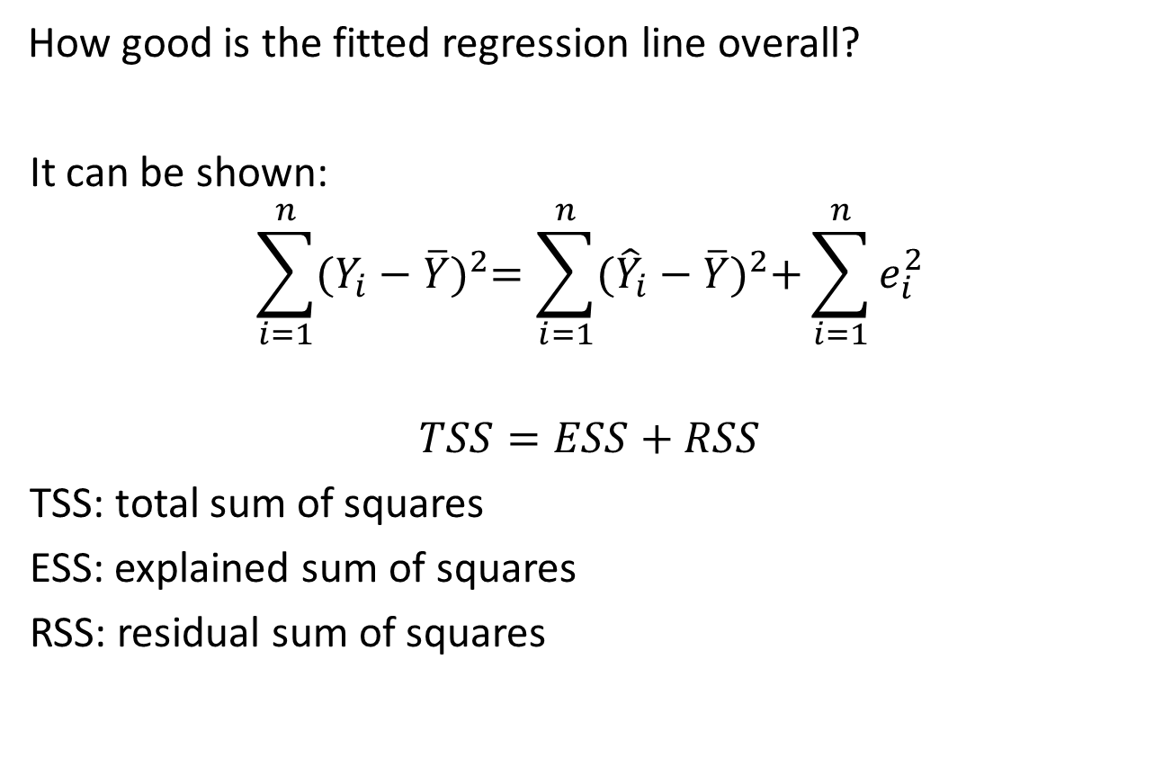

Coefficient of determination $R^{2}$
How good is the fitted regression line overall?
It can be shown:
$$\sum_{i=1}^{n}{{(Y_{i}−\overline{Y})}^{2}=\sum_{i=1}^{n}{{({\hat{Y}}_{i}−\overline{Y})}^{2}+\sum_{i=1}^{n}{e_{i}^{2}}}}$$
$$TSS=ESS+RSS$$
TSS: total sum of squares
ESS: explained sum of squares
RSS: residual sum of squares

Slide 4
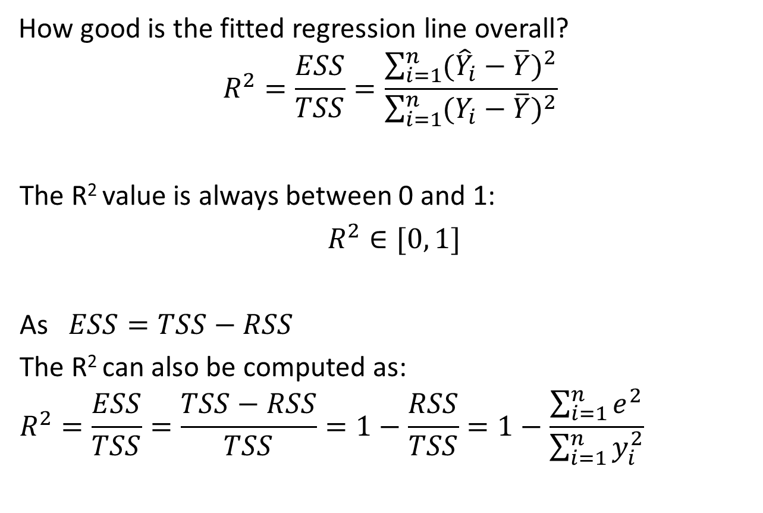
Coefficient of determination $R^{2}$
How good is the fitted regression line overall?
$$R^{2}=\frac{ESS}{TSS}=\frac{\sum_{i=1}^{n}{{({\hat{Y}}_{i}−\overline{Y})}^{2}}}{\sum_{i=1}^{n}{{(Y_{i}−\overline{Y})}^{2}}}$$
The R² value is always between 0 and 1:
$R^{2}∈[0, 1]$
As $ESS=TSS−RSS$
The R² can also be computed as:
$$R^{2}=\frac{ESS}{TSS}=\frac{TSS−RSS}{TSS}=1−\frac{RSS}{TSS}=1−\frac{\sum_{i=1}^{n}{e^{2}}}{\sum_{i=1}^{n}{y_{i}^{2}}}$$

Slide 5
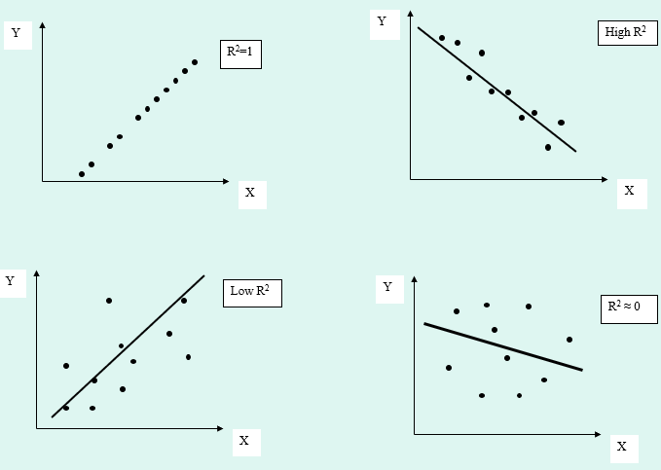
Coefficient of determination $R^{2}$

Slide 6

Coefficient of determination $R^{2}$
Remember the previous example of the effects of advertisement on sales revenues.
The estimated regression equation:
$$Y_{t}=7.604+3.533X_{t}+e_{t}$$

Slide 7
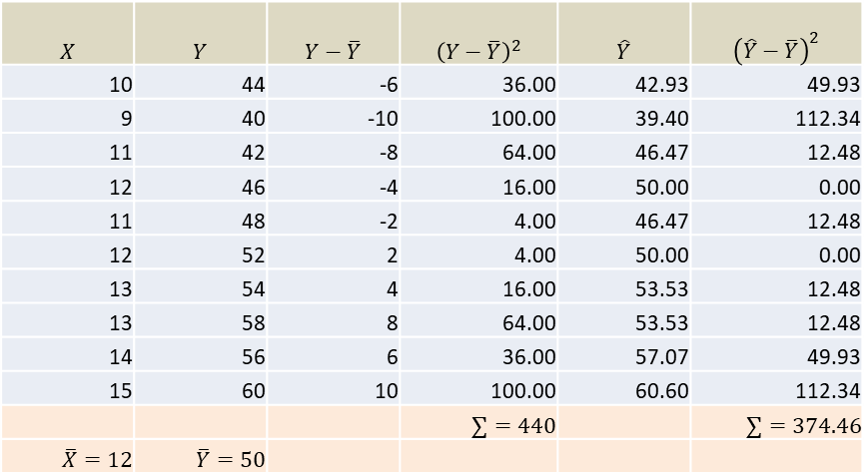

Computation of the R² value.
$$X$$ | $$Y$$ | $$Y−\overline{Y}$$ | $${\left(Y−\overline{Y}\right)}^{2}$$ | $$\hat{Y}$$ | $${\left(\hat{Y}−\overline{Y}\right)}^{2}$$
10 | 44 | -6 | 36.00 | 42.93 | 49.93
9 | 40 | -10 | 100.00 | 39.40 | 112.34
11 | 42 | -8 | 64.00 | 46.47 | 12.48
12 | 46 | -4 | 16.00 | 50.00 | 0.00
11 | 48 | -2 | 4.00 | 46.47 | 12.48
12 | 52 | 2 | 4.00 | 50.00 | 0.00
13 | 54 | 4 | 16.00 | 53.53 | 12.48
13 | 58 | 8 | 64.00 | 53.53 | 12.48
14 | 56 | 6 | 36.00 | 57.07 | 49.93
15 | 60 | 10 | 100.00 | 60.60 | 112.34
 |  |  | $$∑=440$$ |  | $$∑=374.46$$
$$\overline{X}=12$$ | $$\overline{Y}=50$$
$$R^{2}=\frac{ESS}{TSS}=\frac{\sum_{i=1}^{n}{{({\hat{Y}}_{i}−\overline{Y})}^{2}}}{\sum_{i=1}^{n}{{(Y_{i}−\overline{Y})}^{2}}}=\frac{374.46}{440}=0.851$$

Slide 8
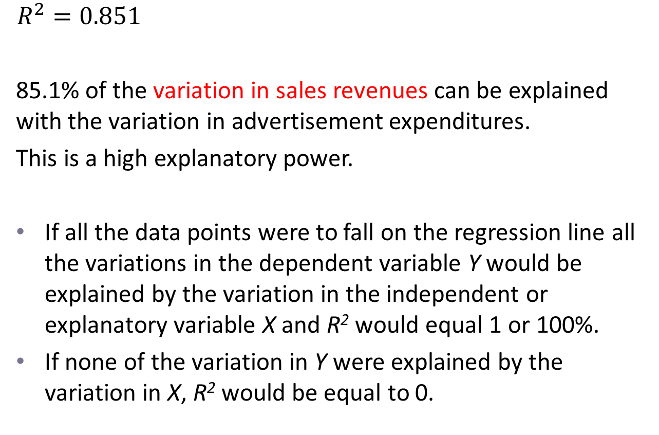
Interpretation of the R² value.
$$R^{2}=0.851$$
85.1% of the variation in sales revenues can be explained with the variation in advertisement expenditures.
This is a high explanatory power.
If all the data points were to fall on the regression line all the variations in the dependent variable Y would be explained by the variation in the independent or explanatory variable X and R² would equal 1 or 100%.
If none of the variation in Y were explained by the variation in X, R² would be equal to 0.

Slide 9
Testing the overall model significance: F test
The F test is a joint test on all the slope coefficients jointly.
The test tries to answer whether the regression model has predictive power or not.
When we are working with a bi-variate regression, the F test will provide the same conclusion as the t test.
As the F test is a hypothesis test, we follow the same steps as in previous tests.

Slide 10
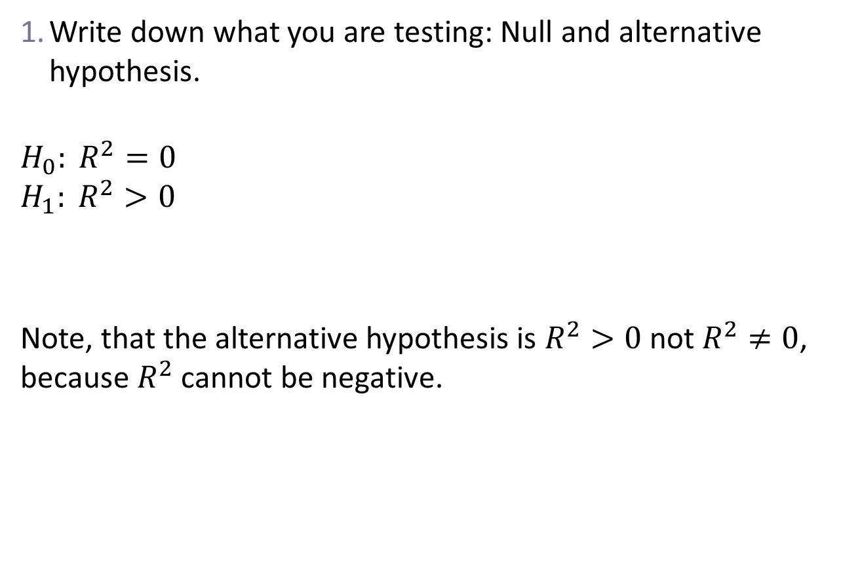
Testing the overall model significance: F test
Write down what you are testing: Null and alternative hypothesis.
$$H_{0}: R^{2}=0$$
$$H_{1}: R^{2}>0$$
Note, that the alternative hypothesis is $R^{2}>0$ not $R^{2}≠0$, because $R^{2}$ cannot be negative.

Slide 11
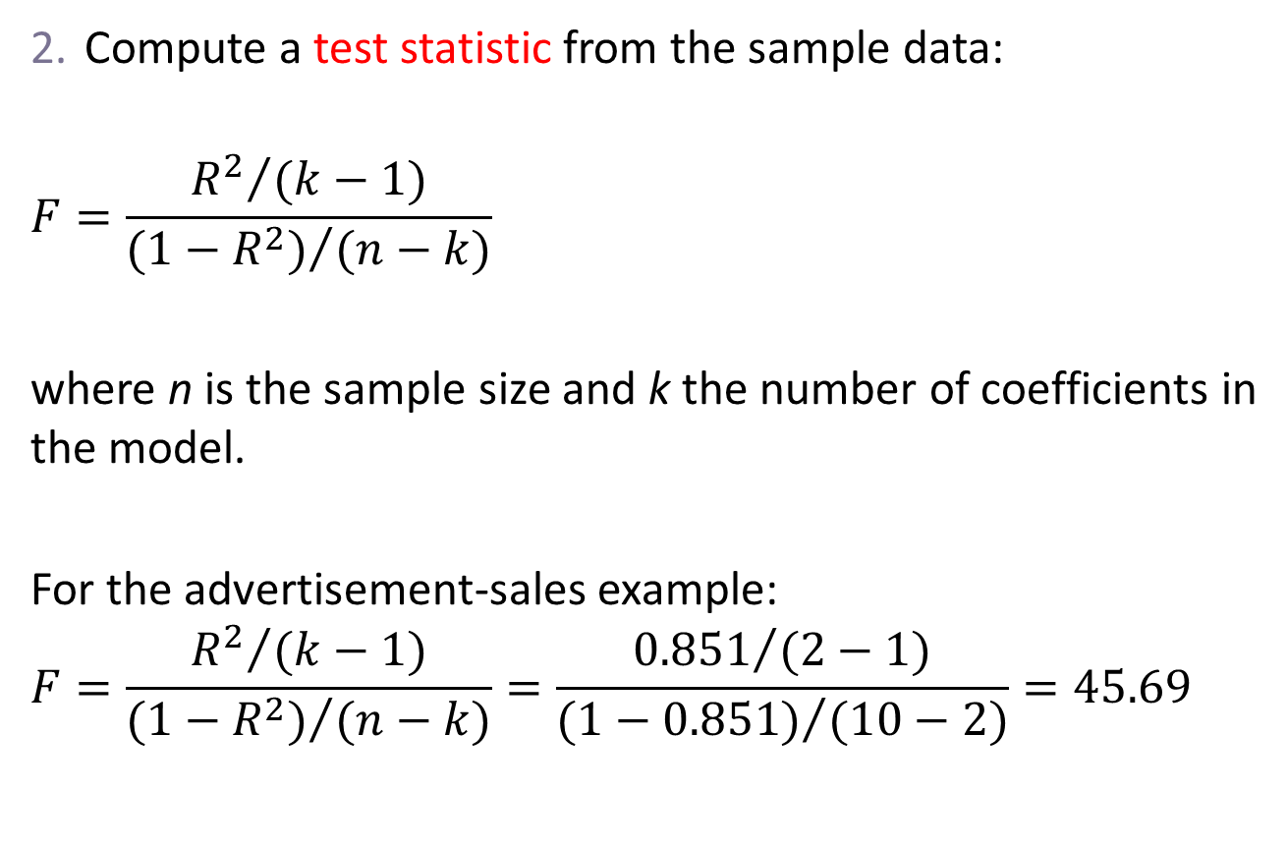
Testing the overall model significance: F test
Compute a test statistic from the sample data:
$$F=\frac{{R^{2}}/{(k−1)}}{{(1−R^{2})}/{(n−k)}}$$
where n is the sample size and k the number of coefficients in the model.
For the advertisement-sales example:
$$F=\frac{{R^{2}}/{(k−1)}}{{(1−R^{2})}/{(n−k)}}=\frac{{0.851}/{(2−1)}}{{(1−0.851)}/{(10−2)}}=45.69$$

Slide 12
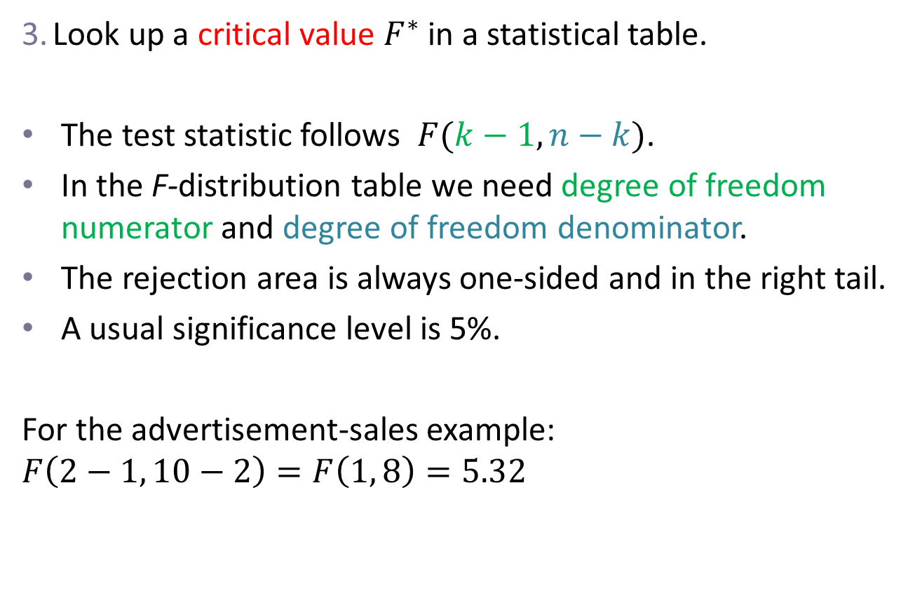
Testing the overall model significance: F test
Look up a critical value $F^{∗}$ in a statistical table.
The test statistic follows $F(k−1, n−k)$.
In the F-distribution table we need degree of freedom numerator and degree of freedom denominator.
The rejection area is always one-sided and in the right tail.
A usual significance level is 5%.
For the advertisement-sales example:
$$F\left(2−1, 10−2\right)=F\left(1, 8\right)=5.32$$

Slide 13
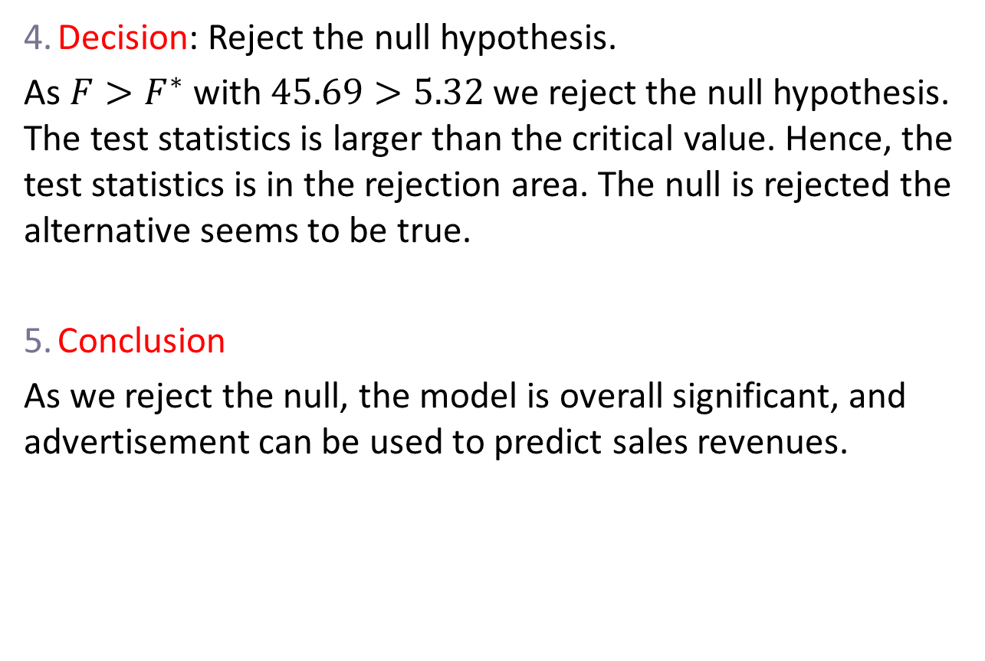
Testing the overall model significance: F test
Decision: Reject the null hypothesis.
As $F>F^{∗}$ with $45.69>5.32$ we reject the null hypothesis. The test statistics is larger than the critical value. Hence, the test statistics is in the rejection area. The null is rejected the alternative seems to be true.
Conclusion
As we reject the null, the model is overall significant, and advertisement can be used to predict sales revenues.

Slide 14
Outlook
In study year 2, we will do more regression analysis in UMET9W-30-2- Econometric Analysis and Professional Advancement.

